Slide 1

Embrace the Analogical
The value of understanding analogical reasoning
and the metaphors we code by

Slide 2
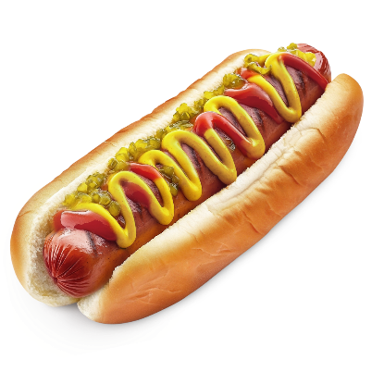
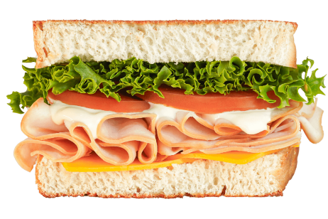
Is a Hotdog a Sandwich?
=
?

Slide 3


Slide 4
Is a Hotdog a Sandwich?
=
?

Slide 5
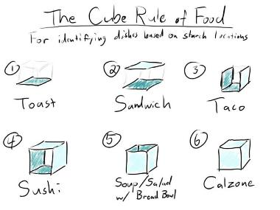
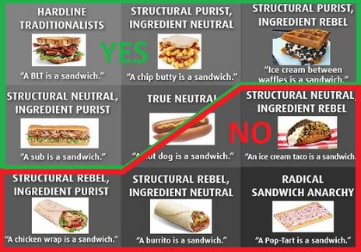
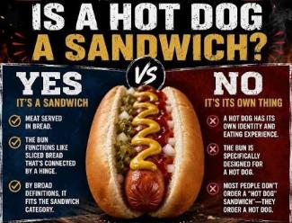
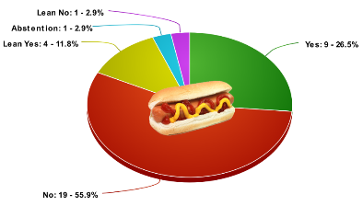
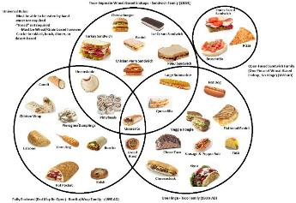

Slide 6
Is Sandwich a Set?
🥪(x) ⇔ …
Need a necessary and sufficient condition

Slide 7
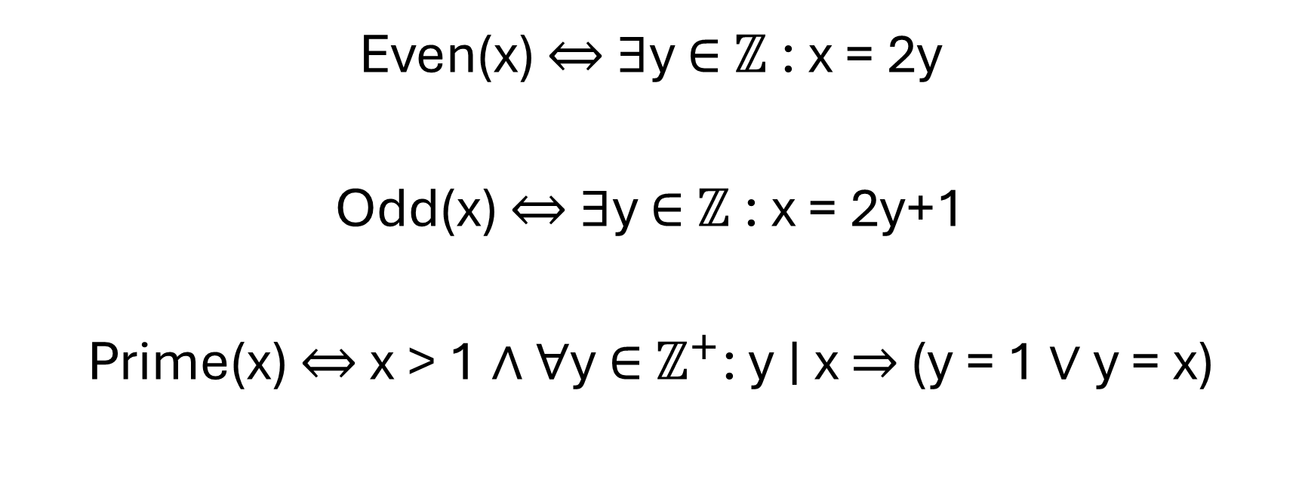
Sets can be very useful
Even(x) ⇔ ∃y ∈ $ℤ$: x = 2y
Odd(x) ⇔ ∃y ∈ $ℤ$: x = 2y+1
Prime(x) ⇔ x > 1 ∧ ∀y ∈ $ℤ^{+}$: y ∣ x ⇒ (y = 1 ∨ y = x)

Slide 8
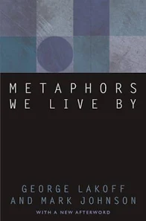
“This set-theoretical concept of a category does not accord with the way people categorize things and experiences.”

Slide 9


Foundational Metaphors
Orientational Metaphors
Up
Down

Slide 10
Foundational Metaphors
“The deadline is approaching quickly.”
“We’re moving into the Christmas season.”
Spatial Metaphors for Time

Slide 11
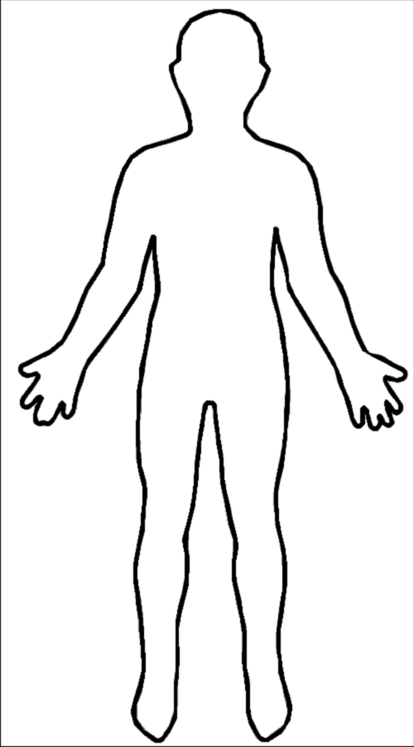
Foundational Metaphors
The Container Metaphor
In or Out – but not both or neither
Experiential root of set theory
Significant utility
But…
outside
inside
boundary

Slide 12
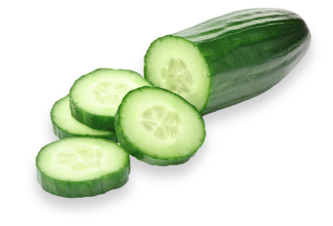


Reality Isn’t Set Based
Fruit
Vegetable

Slide 13

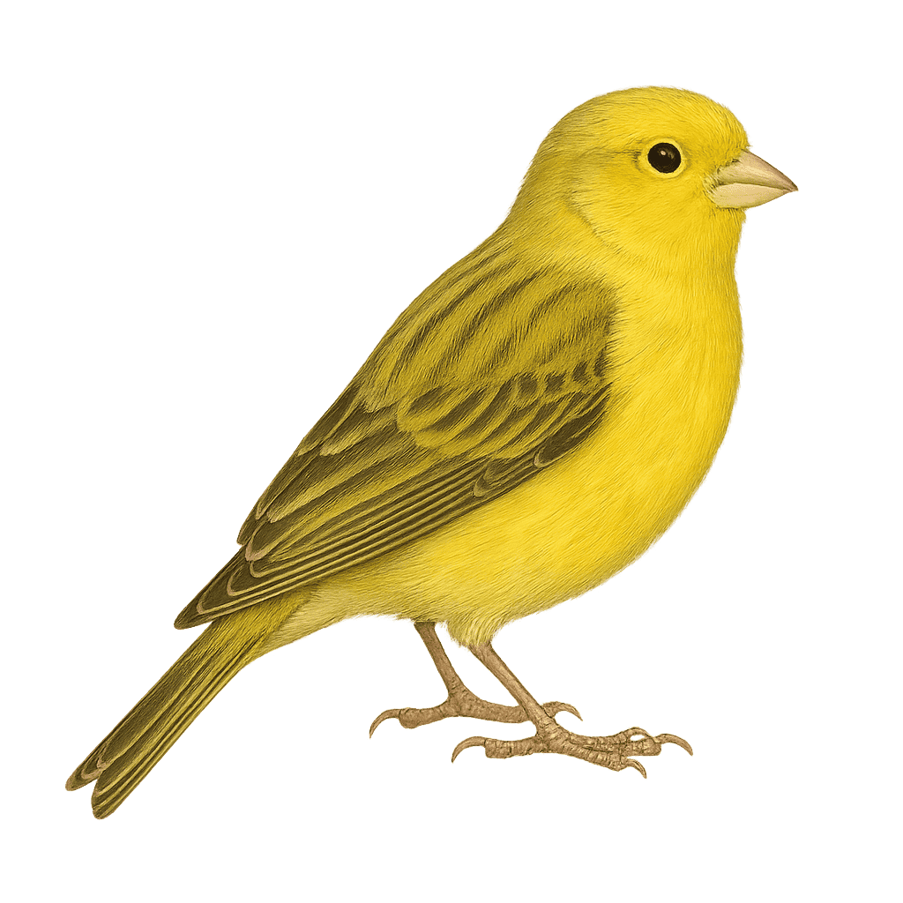
Cognition Isn’t Set Based
Think of a bird…
Which one is closer to what you had in mind?

Slide 14
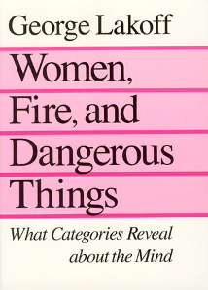
Radially Structured Prototypical Categories

Slide 15
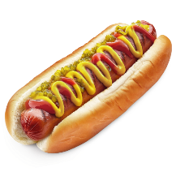

Which sounds weirder?
“It’s like a sandwich, but it’s made on an elongated hinged bun”
“It’s like a sandwich, but it’s made on two slices of bread”
>

Slide 16
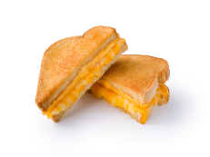
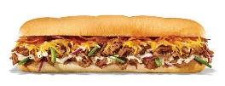

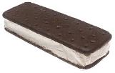

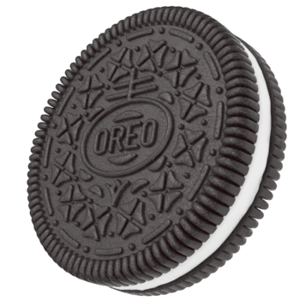
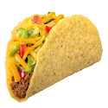
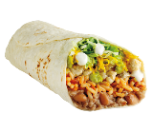
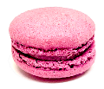

Slide 17

“The ceaseless activity of making mappings between freshly minted mental structures (new percepts) and older mental structures (old concepts) … constitutes the analogical fabric of thought …”

Slide 18
Surfaces
Immediate perception
Concrete features
Sensory, literal
Context specific
Essences
Conceptual structure
Abstract patterns
Cognitive, relational
Independent of context

Slide 19



Thinking ≈ Continual Analogy Making
“Analogy-making, far from happening at rare intervals, occurs at all moments, defining thinking from top to toe…”

Slide 20
Abstraction
Stripping away surface details to retain a deeper relational structure
Generalization
Extending from several cases to a broader category or pattern

Slide 21
(Essences)
Abstract
Specific
General
Concrete
(Surfaces)

Slide 22
Good Analogies
Identify the essential
Ignore the irrelevant
Preserve relational structure
Support useful inference
Bridge different domains
Poor Analogies
Depend on surface resemblance
Map the salient but irrelevant
Ignore structural differences
Encourage invalid inference
Fail to extend across domains

Slide 23
So what?

Slide 24
There are two hard problems in computer science:
0. Cache invalidation
1. Naming things
2. Off-by-one errors

Slide 25

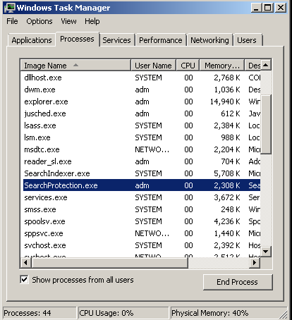
What’s in a name?
Glass and wood
Hinged or sliding
Handle mechanism
Region of colored pixels
Drag, min, max, close
Running program
Frame
Bounded view
Open / close

Slide 26

What’s in a name?
public class CarFactory : IFactory<Car, CarSpec>
{
public CarFactory(
...
)
public Car Create(CarSpec spec)
{
var car = new Car();
...
return car;
}
}
Concrete and steel
Conveyors, stations, stocks
Workers performing tasks
Sequence of characters
C# abstract syntax tree
Class inheriting generic interface
Encapsulation of construction
Repetitive consistency

Slide 27
To name things well
Abstract away the details
Look for metaphors and analogies
Hint: #2 gets easier when
You understand how metaphors and analogies work
You have a lot of other mental models to draw on

Slide 28
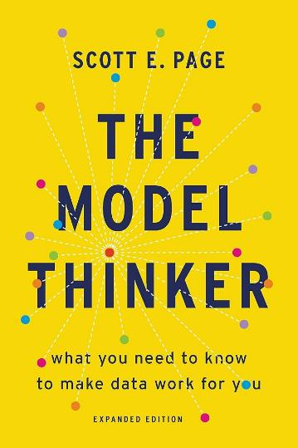
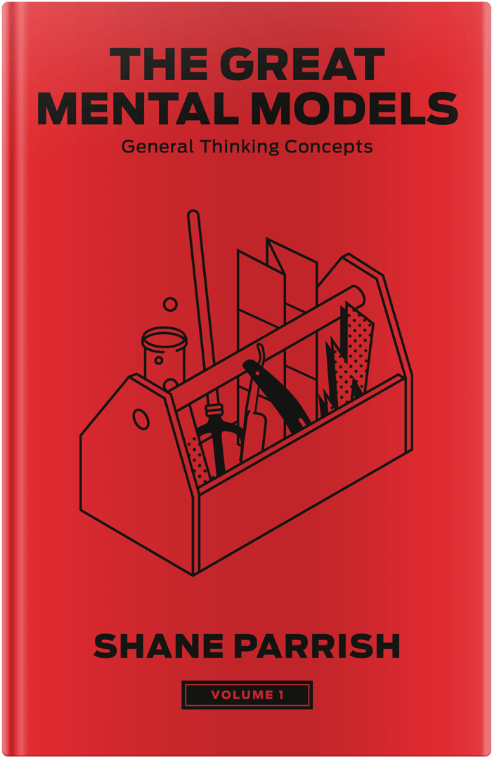

Slide 29
“All models are wrong, but some are useful.”
George E.P. Box
“The map is not the territory.”
Alfred Korzybski

Slide 30
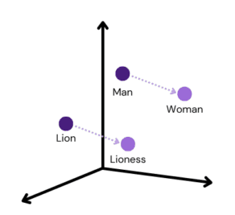
How does this relate to AI?
LLMs: Massive learned model of analogical relationships
But!
LLMs are oriented around surfaces, not essences

Slide 31




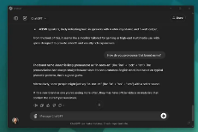
Attempt to reverse engineer experiential semantics
Reality
Experience
Records
Training
Inference
from a massive number of experiential records

Slide 32
Surfaces
Concrete (syntactic) patterns
Positional (attentional) relations
Derived from data about experience
LLMs can only operate here
Essences
Abstract (semantic) patterns
Analogical / metaphorical relations
Derived directly from experience
We can operate here

Slide 33
LLMs can’t discover novel abstractions
Novel abstractions:
Derive from analogies about embodied experience
Require us to abstract surfaces into essences
Form our deep insights into problem and solution domains

Slide 34

Wrapping it up
Metaphors and analogies
Not just for prose and poetry!
Cognitive categories and analogical reasoning
Better naming
Improved communication
Novel abstractions
Build a toolbox of diverse mental models!
(hey look – a metaphor!)

Slide 35


So is a Hotdog a Sandwich?
=
?
“Kinda”

Slide 36

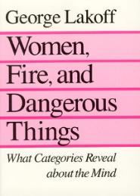

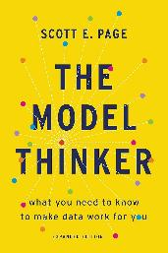

Slide 37

Andrew Kuipers
Software Development, Architecture, Philosophy

